Slide 1
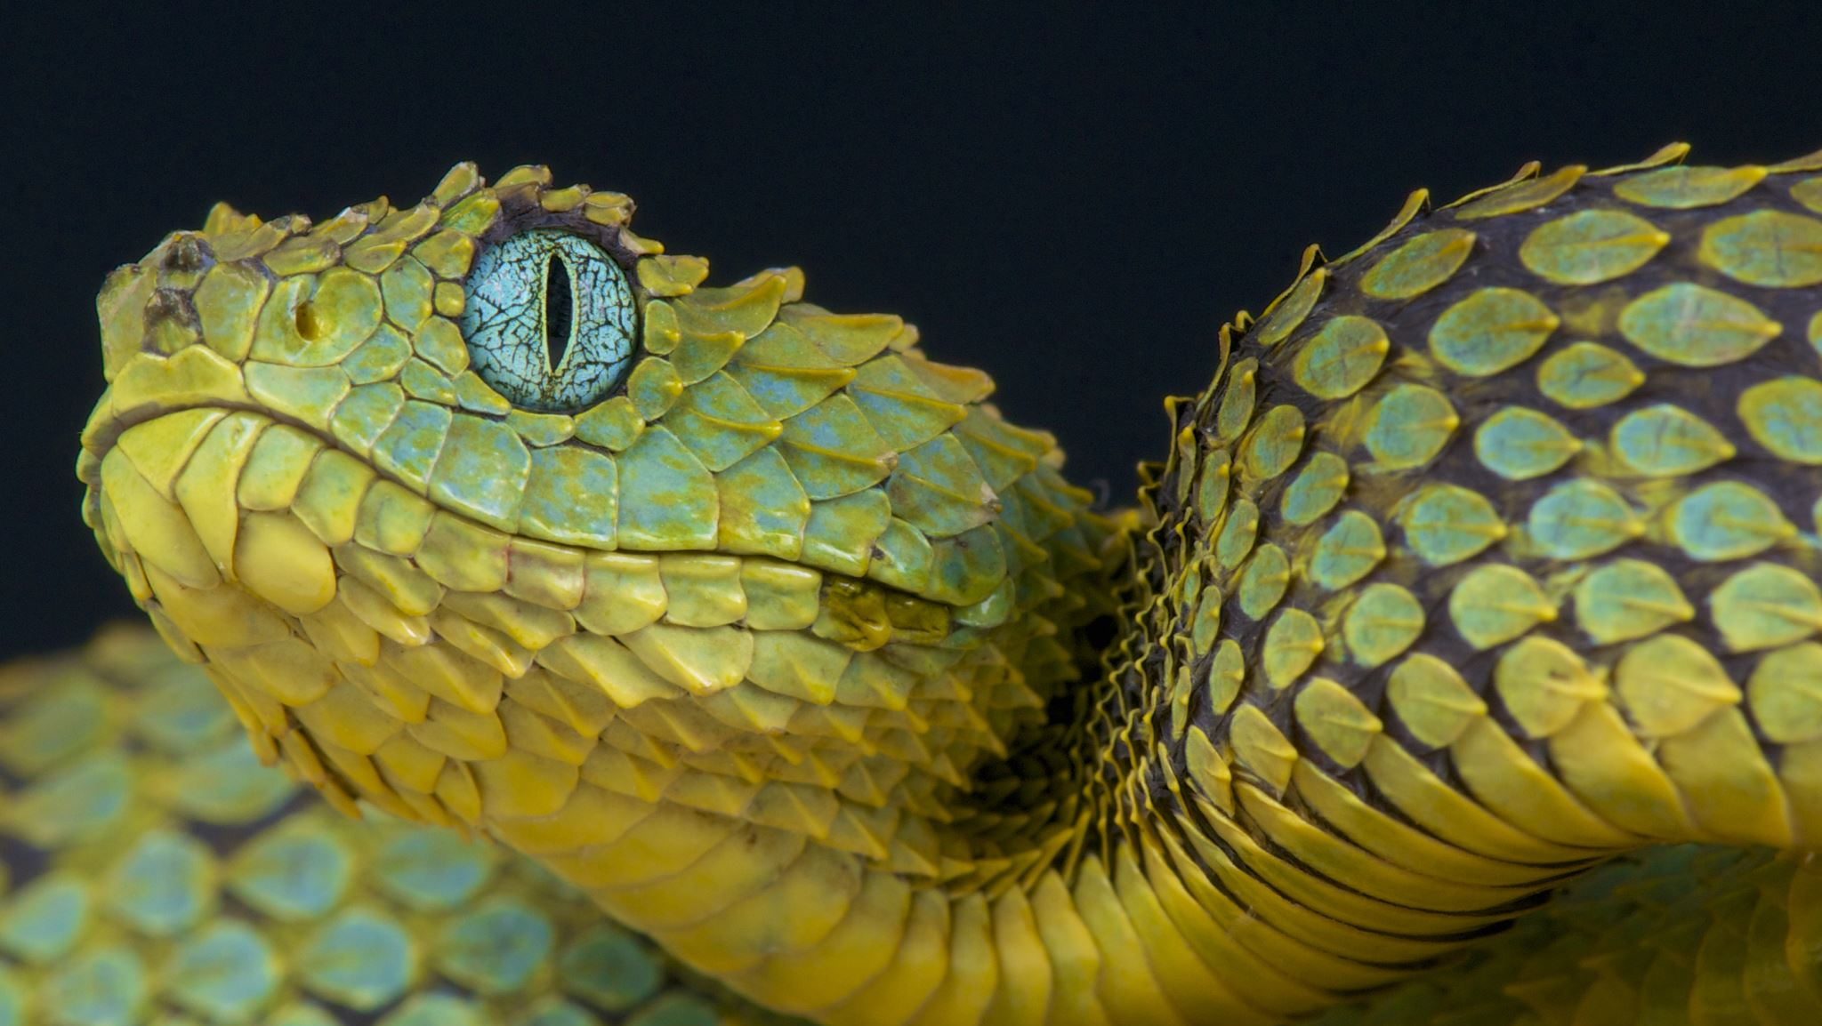
SERPENT Rescuebot
Dania Al Hakim, Hanan Korabi, Shehroz Bashir Malik, Kaloyan Staykov, Cristian Cernat

Slide 2

What Serpent achieves
Serpent assists in rescue after environmental disasters, such as:
Earthquakes
Tsunamis
Cyclones
Hurricanes
Mainly traverse through rubble and find survivors.
Will be used first responders, governments, and non-government organizations

Slide 3

How it works
PIR, IR (Temperature sensor)
Used for detecting people under rubble by heat radiation
Sound sensor
Used for sonar for underwater purposes, such as seabed mapping
Light + Camera
Useful for navigation underwater
GPS, Barometric pressure for altitude
Used underwater
Gyroscopes in all segments
Used for orientation awareness
Microphone and Speaker
Used for communication with the victim

Slide 4
Constraints and obstacles
Environmental Constraints:
Design constraints:
Components:
Water Proofing
Dust Proofing
Density – materials used should be no denser than 10g/m3, for it to be the same as water
Construction:
Room
Resilience
Flexibility

Slide 5
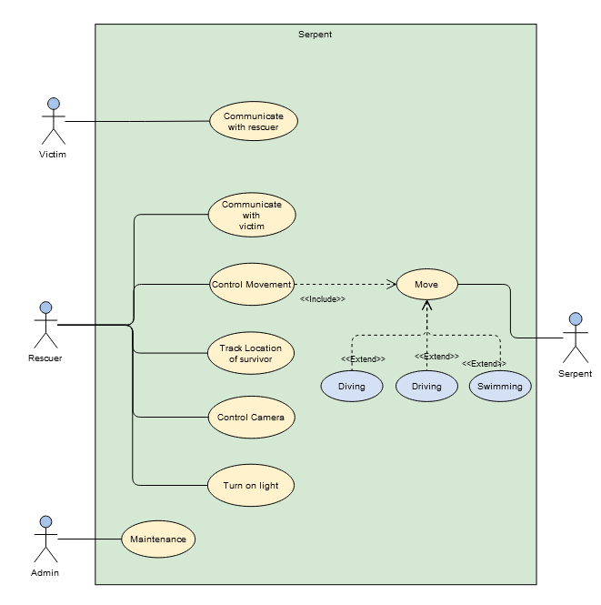

Slide 6
Techniques for movement
Land
Pistons: responsible for bending in all directions on each joint between segments.
Water
Wheels: might show useful even underwater if it comes to the case of contact with seafloor.
Propellers: great in aquatic environment but disadvantageous on dry land, as they play no significant role other than dead weight and contact with the surface

Slide 7
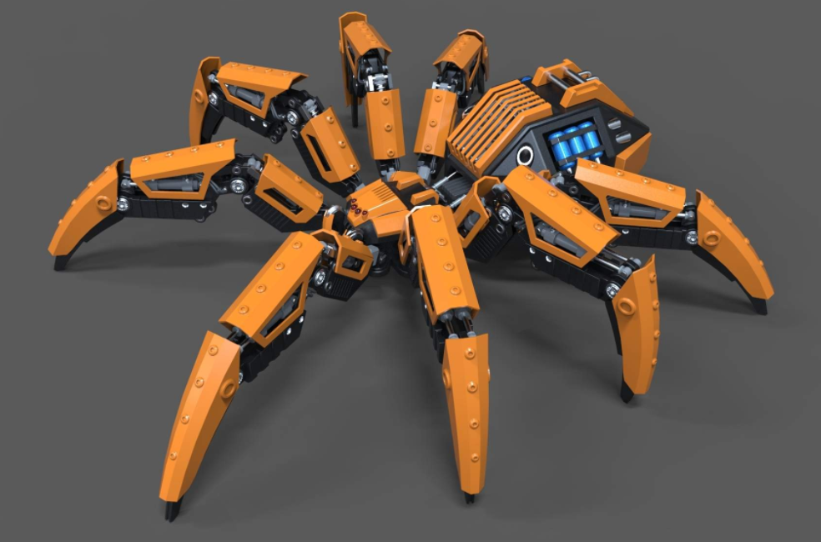
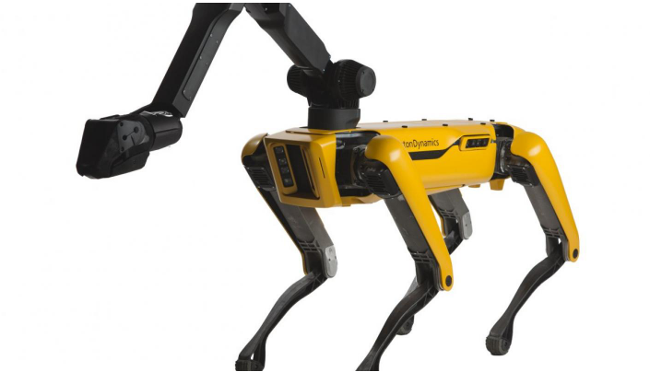

Design methodology
Spider design:
Enables wall climbing and traverses' large pieces of rubble.
Does not support most of the requirements stated
Larger build
Not be flexible.
Boston dynamics like-dog design
Larger build.
Snake Body design
Fits through cracks and small spaces due to its small diameter
Can be extended to support more components
Compact Robust Design which withstands large amounts of pressure
The ability to go into water bodies is also supported by this design.

Slide 8
